Slide 1
ZFINX working in gcc and binutils
Cas PLCT LAB Jiawei
jiawei@iscas.ac.cn

Slide 2
The whole patch is uploaded into：
https://github.com/pz9115/riscv-gcc (branch riscv-gcc-10.2.0)
https://github.com/pz9115/riscv-binutils-gdb (branch riscv-binutils-2.35)

Slide 3
What we had done:
add an elf header and set ABI flags with Zfinx in binutils
add mabi options and ban all FP regs use with Zfinx
What we doing:
modifying instructions both in binutils and gcc to support GR uses
Problems we have:
a code for Zfinx ABI flag
a version of draft that include Zfinx extension
some tests to verify if Zfinx work well
some examples for modifying instruction correctly
assembler errors when run a test use gcc

Slide 4
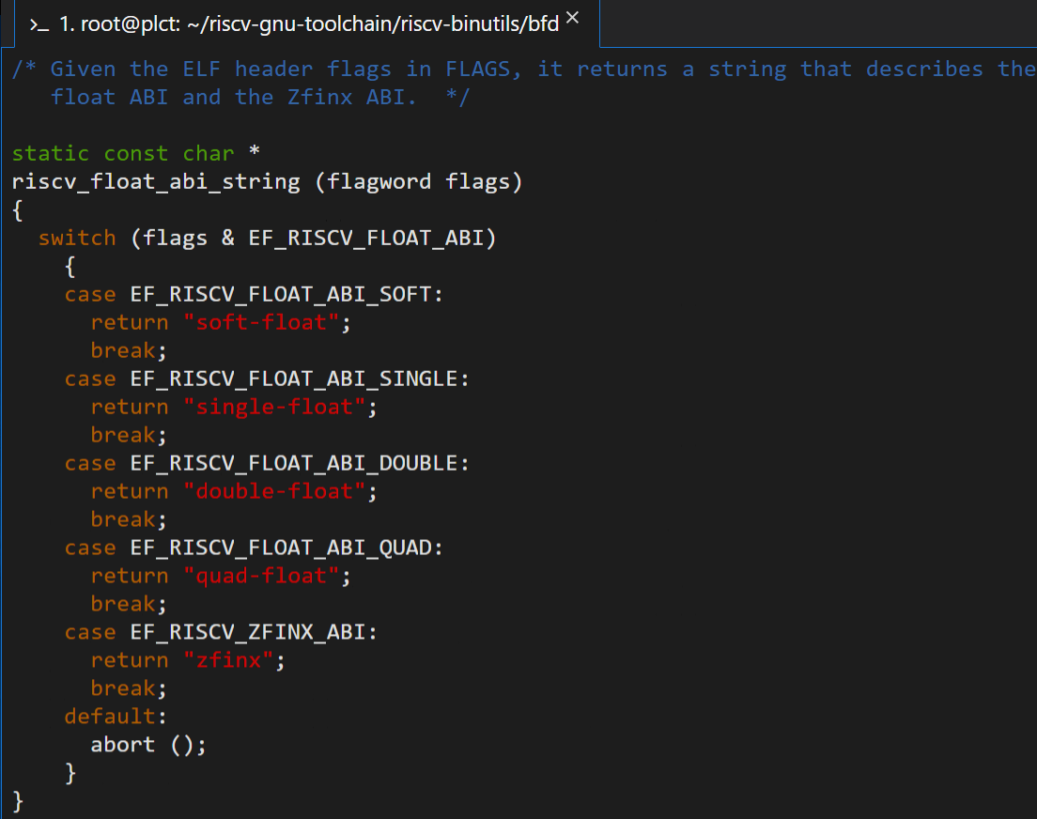
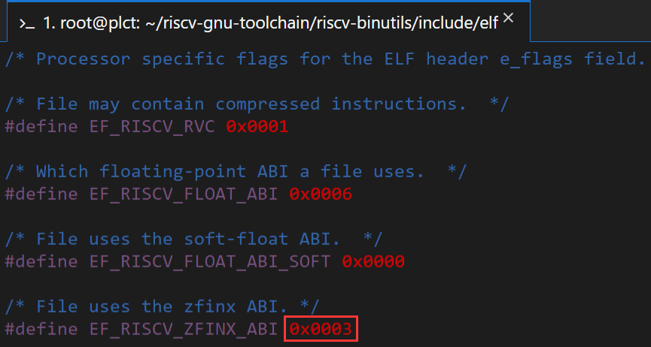
In binutils:
We added an elf header flags call “zfinx” to mark zfinx code

Slide 5
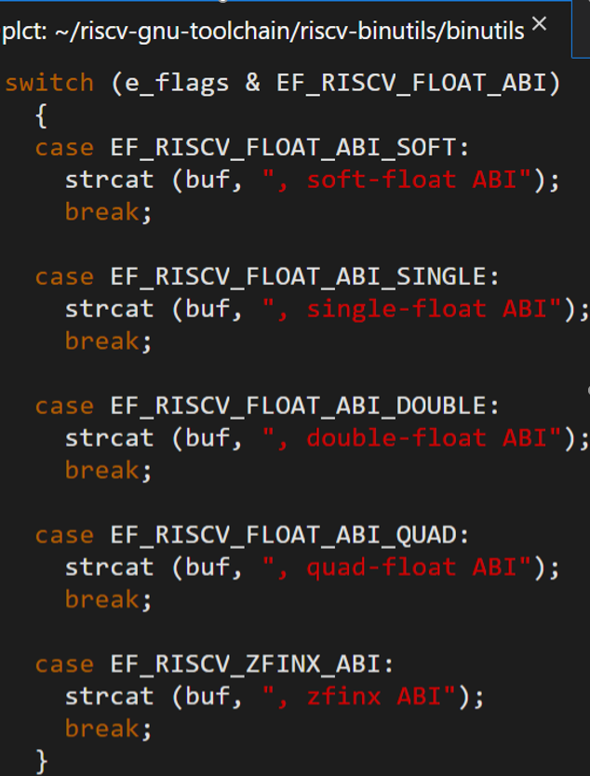
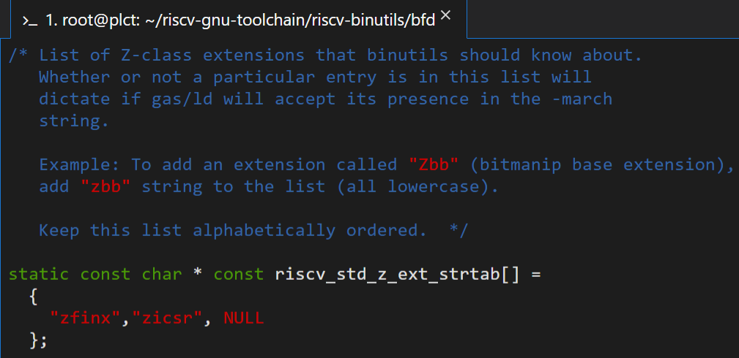

Slide 6
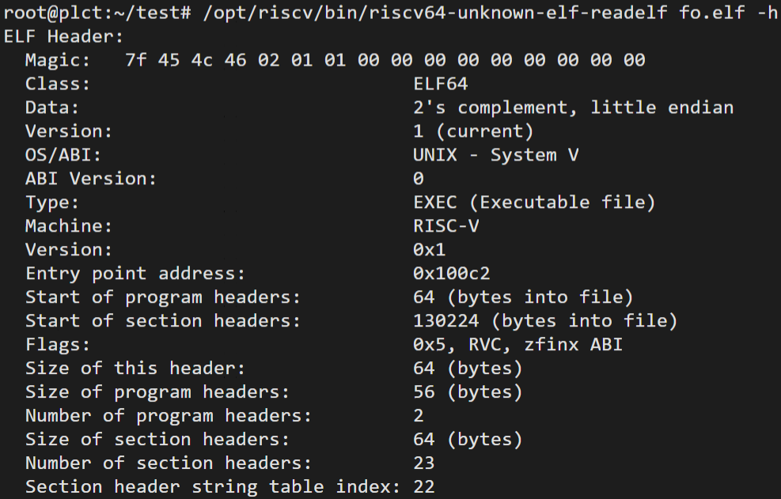
We need some tests to verify is it work correctly

Slide 7
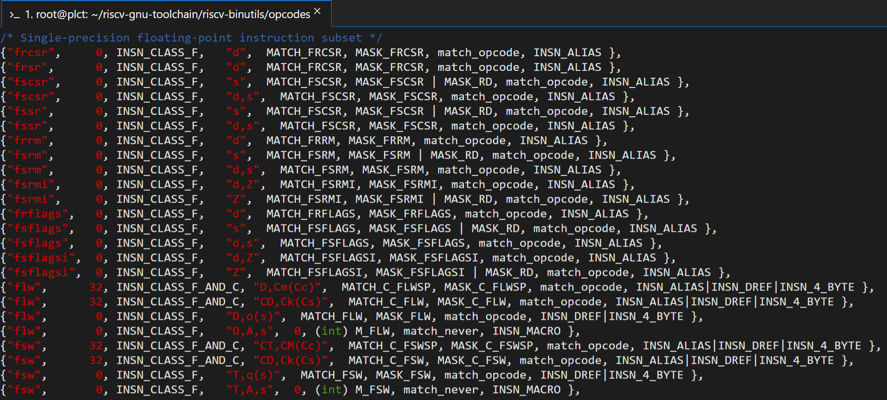
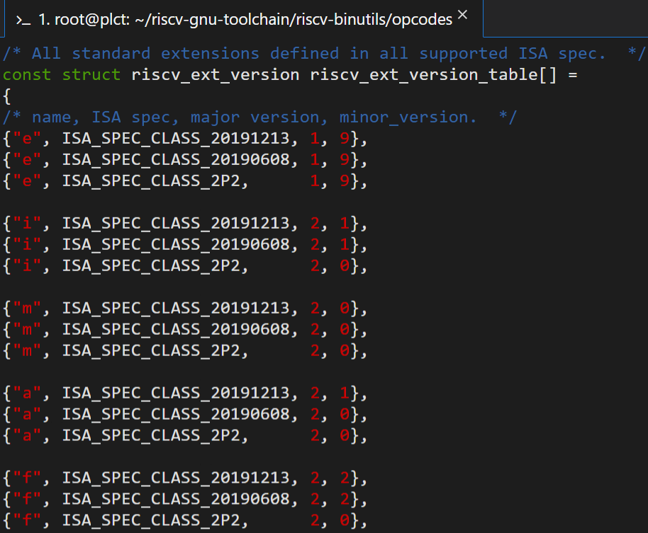
To modify FP instructions to accept integer registers in binutils

Slide 8
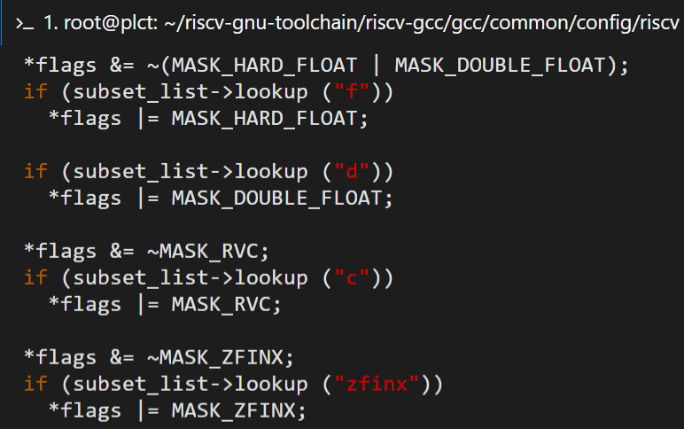
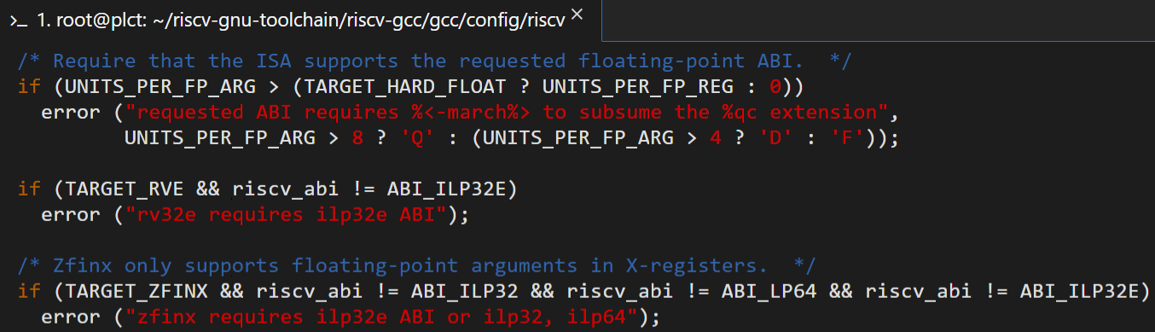
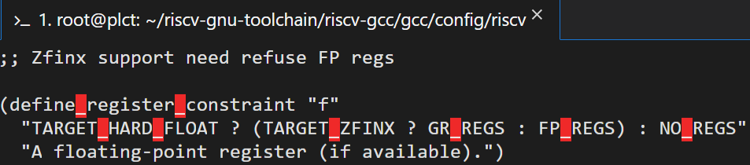
In GCC:
We added the march option “zfinx” and ban FP regs use when build with it

Slide 9
